Slide 1


Slide 2

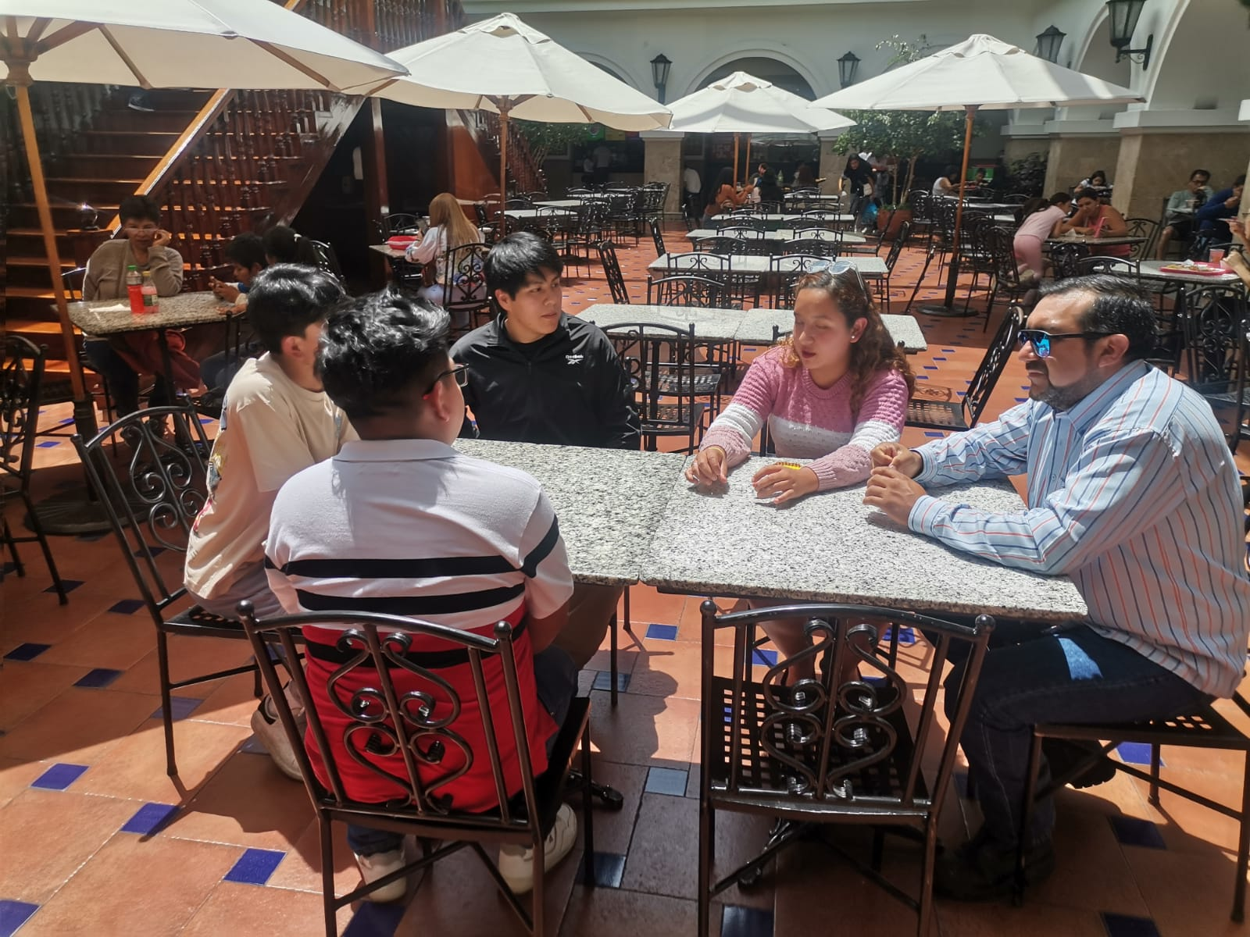

Alan Arias
Camila Bohórquez
Robinson Bonilla
Mateo Camacho
MANAGE PROFILES

Slide 3
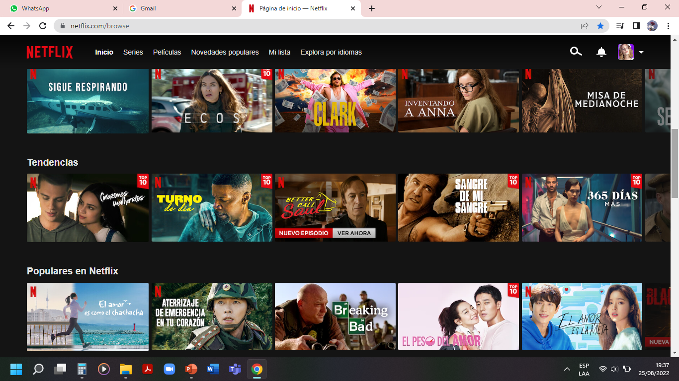





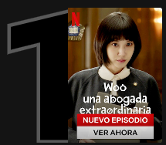
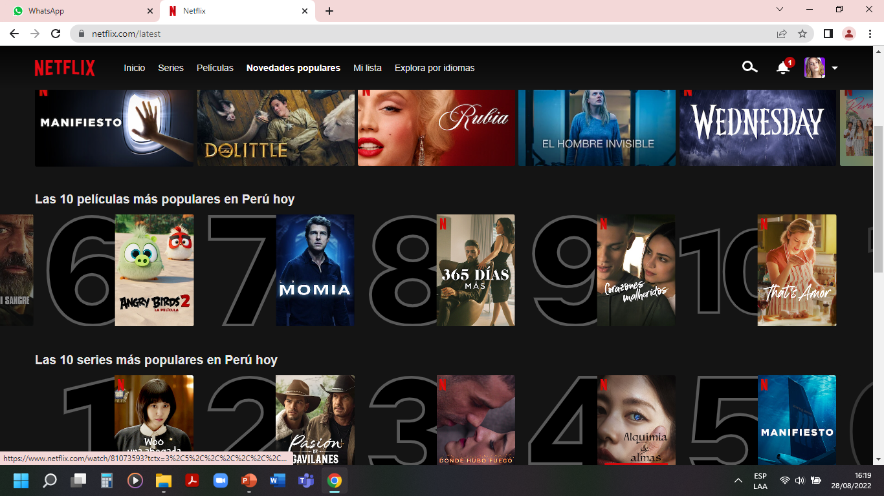
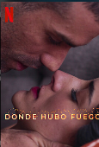
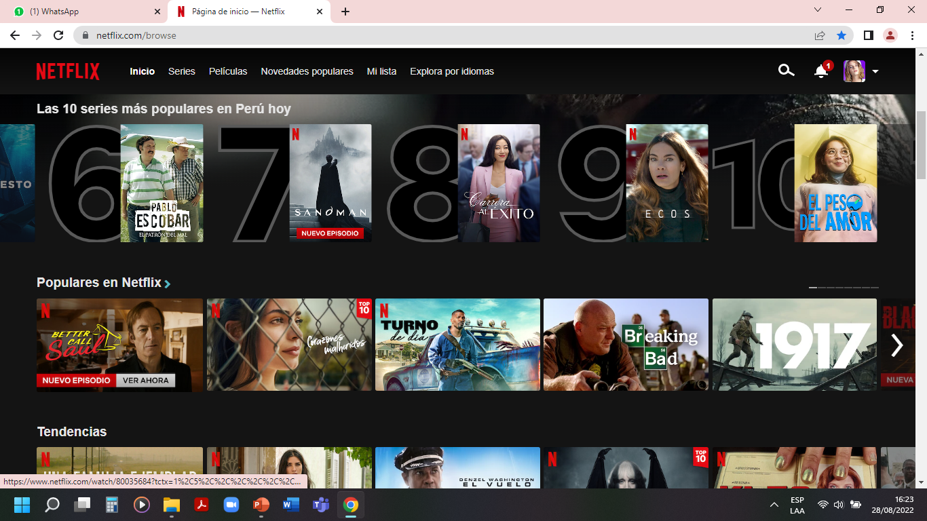
SAMC is a virtual ordering program that focuses on making the work of the waiter and cashier easier.
SERIE
SAMC
N° 1 en “tu país” hoy
Sistema de automatización de mesero y caja (WAITER AND CASHIER AUTOMATION SYSTEM).
Reproducir
i
Más información
2
3
4
5
6
7
Las 10 más populares en “tu país” hoy

Slide 4

SAMC
T1:E1 “Episodio 1”
50:00
10
10

Slide 5
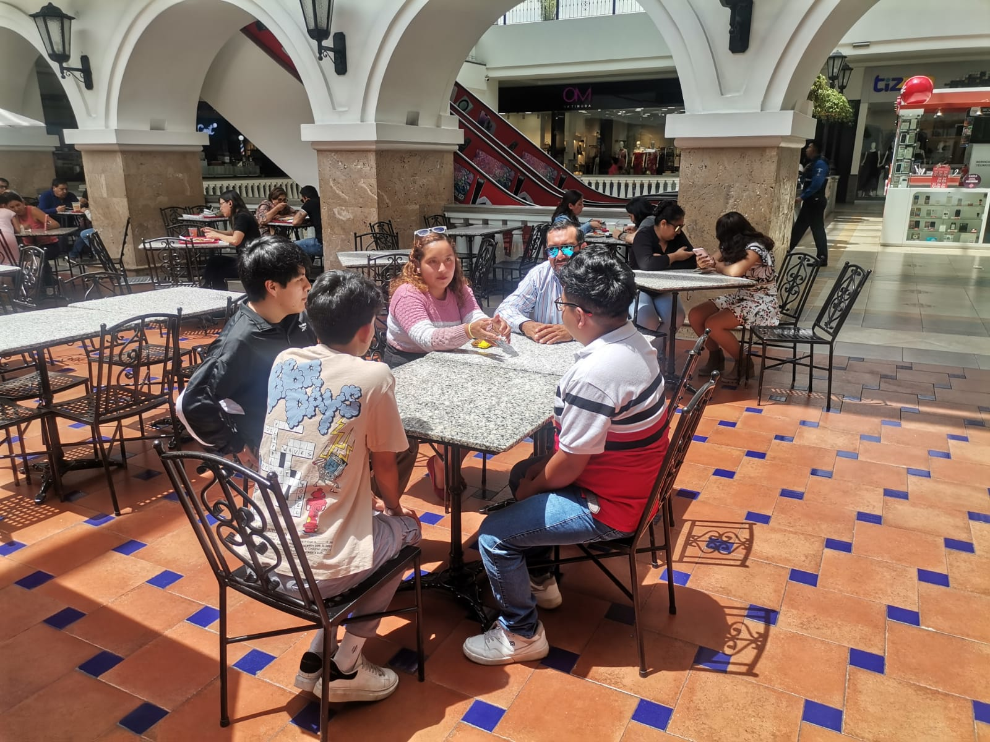
Customer
TEXTO
Our client's name is Henrry Bohorquez, owner of the Guatitas de la Javi establishment.
50:00
10
10
Escribe el título T1:E1 Episodio 1

Slide 6
Problem
Lack of time to take orders from all customers.
We need to implement an automated system that allows the immediate registration of orders and their delivery to customers' tables.
50:00
10
10
Escribe el título T1:E2 Episodio 2

Slide 7
Requirements
As client requirements, we are asked for an easy-to-use app for clients where the following activities can be carried out.
1.-Scan the QR code
2.-Display the options menu
3.-Make order, enter data, payment methods, comment on the attention and performance of the establishment, finalize the order.
50:00
10
10
Escribe el título T1:E2 Episodio 2

Slide 8
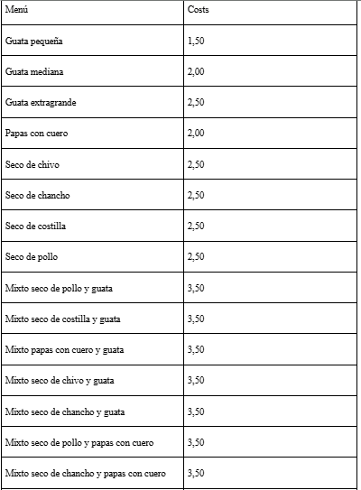
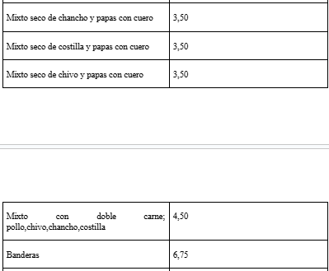
Menu
25:00
10
10
Escribe el título T1:E3 Episodio 3

Slide 9
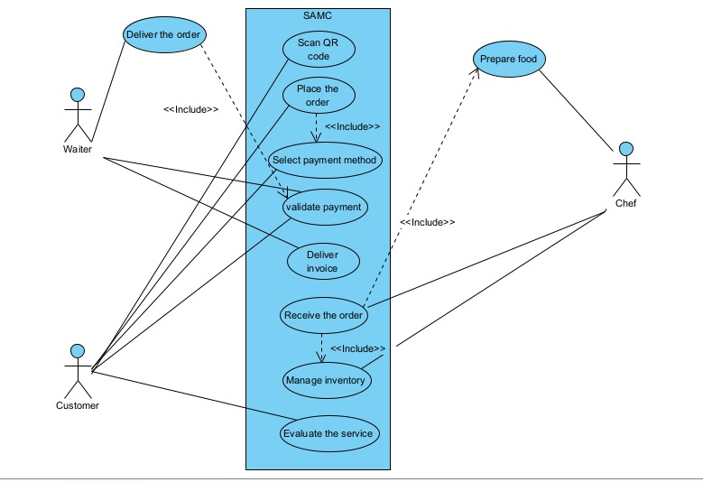
USE CASE DIAGRAM
50:00
10
10
Escribe el título T1:E2 Episodio 2

Slide 10
CLASS AND METHODS
SAMCApp Class (Main View)
main(): Controls the main program flow.
placeOrder(): Registers a new order.
printBill(): Prints the customer invoice.
printSaleNote(): Generates a sales note.
leaveComment(): Stores customer comments.
adminPermissions(): Manages inventory (admin-only).
50:00
10
10
Escribe el título T1:E2 Episodio 2

Slide 11
CLASS AND METHODS
ManageFileJson Class (JSON File Management) saveBillToJson(), saveSaleNoteToJson(): Save invoices and sales notes.
getCustomerById(): Searches for a customer in the file.
getOrderByCustomer(): Retrieves an order by ID.
saveQuantitiesToJson(), loadQuantitiesFromJson(): Save and load inventory.
saveCommentToJson(): Stores comments.
50:00
10
10
Escribe el título T1:E2 Episodio 2

Slide 12
CLASS AND METHODS
MenuItem Class (Menu Management)
initializeMenu(): Initializes the menu.
displayMenu(): Displays the menu on-screen.
getMenuItemById(): Searches for an item by ID.
reduceInventory(): Updates the inventory.
50:00
10
10
Escribe el título T1:E2 Episodio 2

Slide 13
CLASS AND METHODS
Customer Class (Customer Data)
Attributes:
name, idCard, email, address, phoneNumber: Customer data.
Getters and setters for each attribute.
toString(): Displays complete customer information.
50:00
10
10
Escribe el título T1:E2 Episodio 2

Slide 14
CLASS AND METHODS
Order Class (Order Management) Attributes:
orderId, customerId, customerName, orderedItems, tableNumber, orderDate, saleNote: Order details.
calculateOrderTotal(): Calculates the total amount.
getItems(): Returns the ordered items.
50:00
10
10
Escribe el título T1:E2 Episodio 2

Slide 15
CLASS AND METHODS
Billing Classes Bill Class: Generates detailed invoices. SaleNote Class: Creates sales notes.
Common Attributes:
customer, order, total, date.
Methods:
toString(): Generates textual representations.
50:00
10
10
Escribe el título T1:E2 Episodio 2

Slide 16
CLASS AND METHODS
Additional Important Classes
ManageFileCsv: Saves records to CSV files.
AdminPermissions: Handles administrative functions.
Counter: Calculates total costs.
MethodOfPayment: Payment method selection.
50:00
10
10
Escribe el título T1:E2 Episodio 2

Slide 17
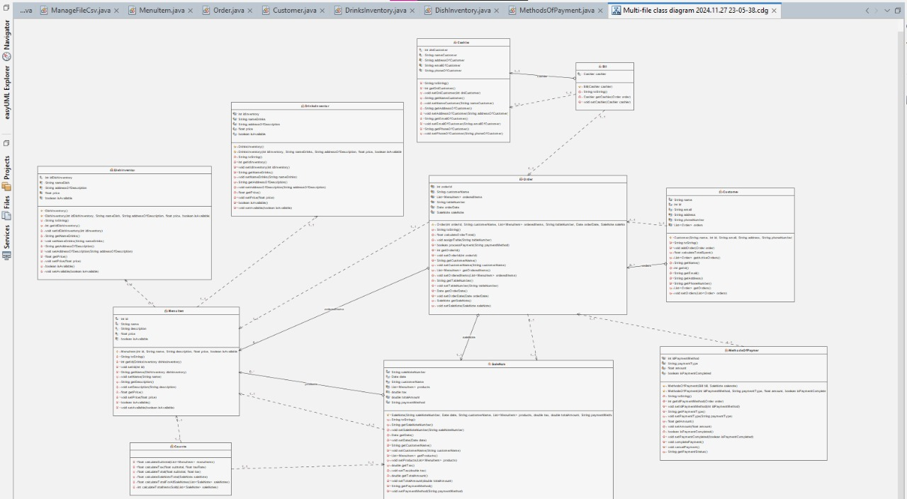
CLASS DIAGRAM
50:00
10
10
Escribe el título T1:E2 Episodio 2

Slide 18

00:50
10
10
Escribe el título T1:E3 Episodio 3

Slide 19

THANK YOU FOR YOUR TIME
02:00
10
10
Escribe el título T1:E3 Episodio 3

